Slide 1
HIEA Technical Forum: August 17-18, 2016
Information Modeling:
Foundation to Semantic Interoperability
“Challenges to an Integrated Approach”
Steve Hufnagel, Session Discussion Moderator
CIMI-FHIM-SOLOR-CQF Integration, Current Report Version at: https://1drv.ms/w/s!AlkpZJej6nh_k9Nd0OKzwn3AM3huog
HL7 CIMI-FHIM Integration Task-Force
Preliminary Report
18 Aug 2016

Slide 2
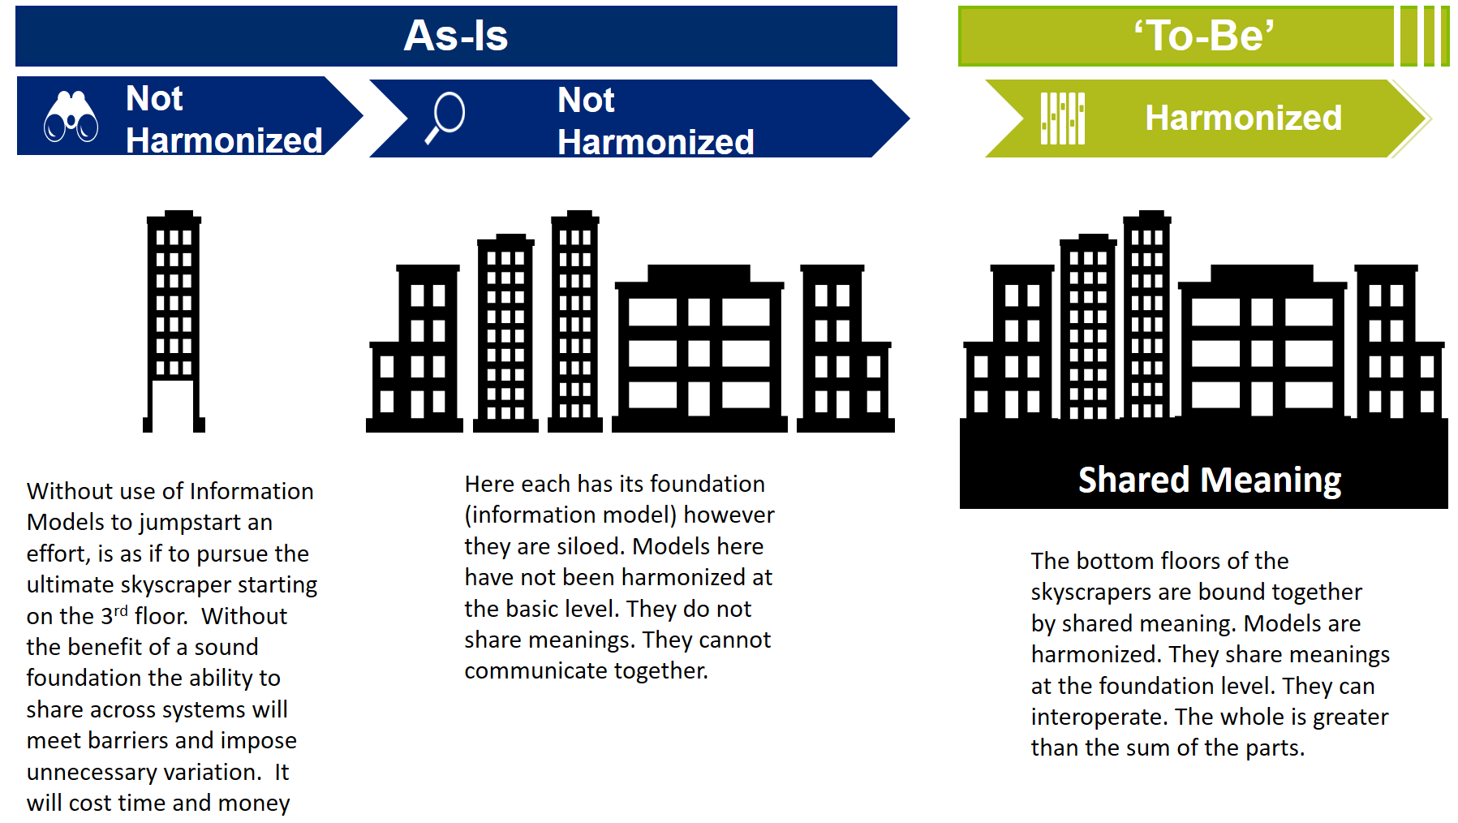
Executive Summary [Keith Campbell and The Open Group]

Slide 3
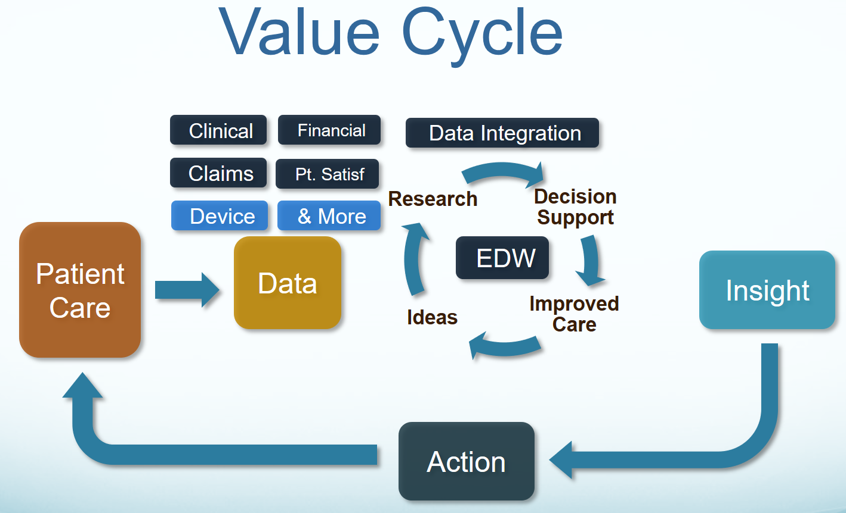
Goal and Key Benefits [Stan Huff]
Our goal is “To help people live the healthiest lives possible;” where, the foundation of a Learning Healthcare System is accurate, computable, data starting with the integration of CIMI, FHIM, SOLOR, CQF and other Information Models into a widely used HL7/ISO standard.

Slide 4
Discussion
Please bring up your questions, issues and suggestions!

Slide 5
Key Challenges
This effort draws upon many existing efforts, and must coordinate these efforts around a single, powerful goal of creating standards for the clinical knowledge content of an electronic health record, care plans and shared data.
It will require combining clinical practice needs with domain modeling, ontologies, medical vocabularies, and information modeling, leveraging existing healthcare information standards.
Federated implementation of the path forward for health information and interoperability, weaving together many concurrent threads by creating shared principles and a common target for future modeling and development efforts.

Slide 6
Discussion
Please bring up your questions, issues and suggestions!

Slide 7
“CIMI-FHIM Integration” Task Force Members
'Linda Bird' <lbi@ihtsdo.org>;
‘Bishop, Robert J.’ <Robert.Bishop2@va.gov>;
Keith E. Campbell <campbell@informatics.com>
'Richard Esmond' <richard.esmond@gmail.com>;
'Jay Lyle' jay.lyle@jpsys.com;
'Stan Huff MD' Stan.Huff@imail.org;
‘Stephen Hufnagel’ SHufnagel@ApprioInc.com;
'Galen Mulrooney' <Galen.Mulrooney@JPSys.com>;
'Claude Nanjo' <cnanjo@cognitivemedicine.com>

Slide 8
Technical and Social Challenges
Real Use Cases, which will be implemented, needed.
HL7/ISO CLIM Ballots and Standards
CIMI Reference Model
Terminology Servers
Federated Development, Configuration Management and Governance
Resources
Implementation targets and support with commercial EHR vendors

Slide 9
Discussion
Please bring up your questions, issues and suggestions!

Slide 10
Thank You
CIMI Co-Chairs:
Linda Bird BIT, IHTSDO, lbi@ihtsdo.org
Galen Mulrooney, FHA and VA, galen.mulrooney@jpsys.com
Harold Solbrig, Mayo Clinic, solbrig.harold@mayo.edu
Stanley Huff, Intermountain Healthcare, stan.huff@imail.org
Members of the following SDOs have participated in CIMI:
IHTSDO, POC: Linda Bird BIT
HL7 Work Groups (PC, CDS, CIC, EHR, SOA, Vocab)
The Open Group Healthcare Forum, Jason Lee POC
ISO/CEN, POCs: Gerard Freriks, William Goossen, Gary Dickinson
Federal Agency staff and contractors have participated in CIMI:
Department of Defense
Veterans Administration
Interagency Program Office
ONC and its Federal Health Architecture
Members of the following Healthcare Organizations have participated IN CIMI:
Intermountain Healthcare
PenRad, Inc.
Results4Care
Faculty, Staff and students from the Following Universities have participated in CIMI:
The University of Utah

